Slide 1
Blockchain
Digital Literacy Class
Budi Rahardjo
2019

Slide 2
Have you heard of Bitcoin? Cryptocurrency?

Slide 3
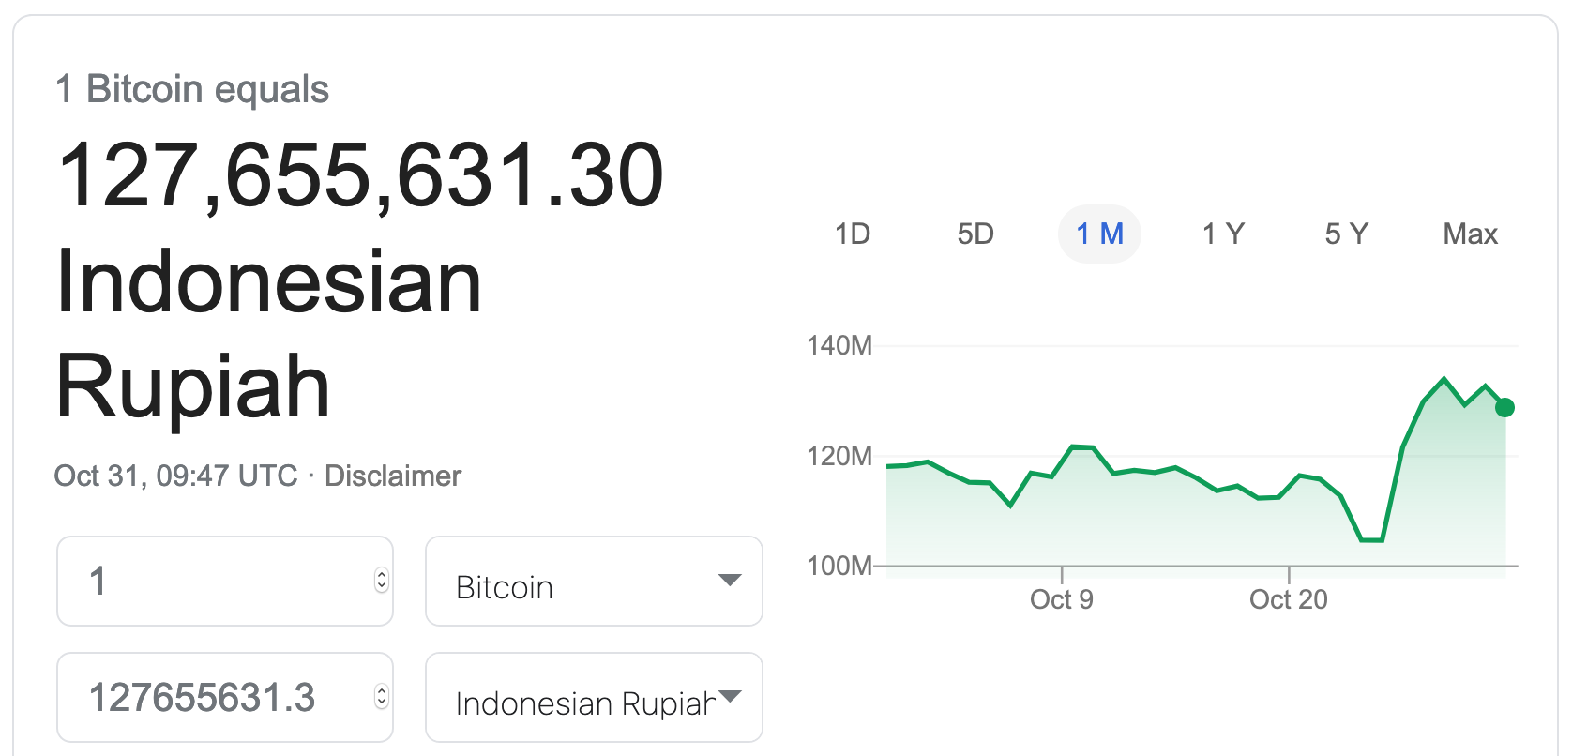

Slide 4



Blockchain $≠$ Bitcoin

Slide 5
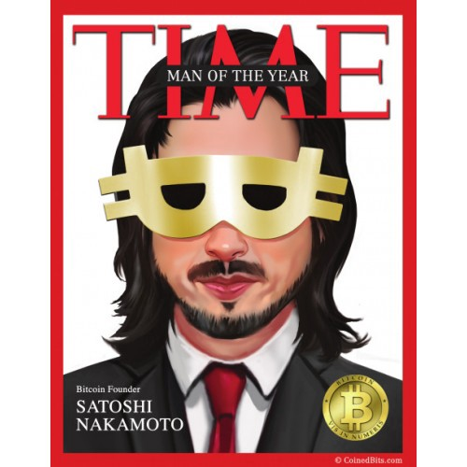

Slide 6
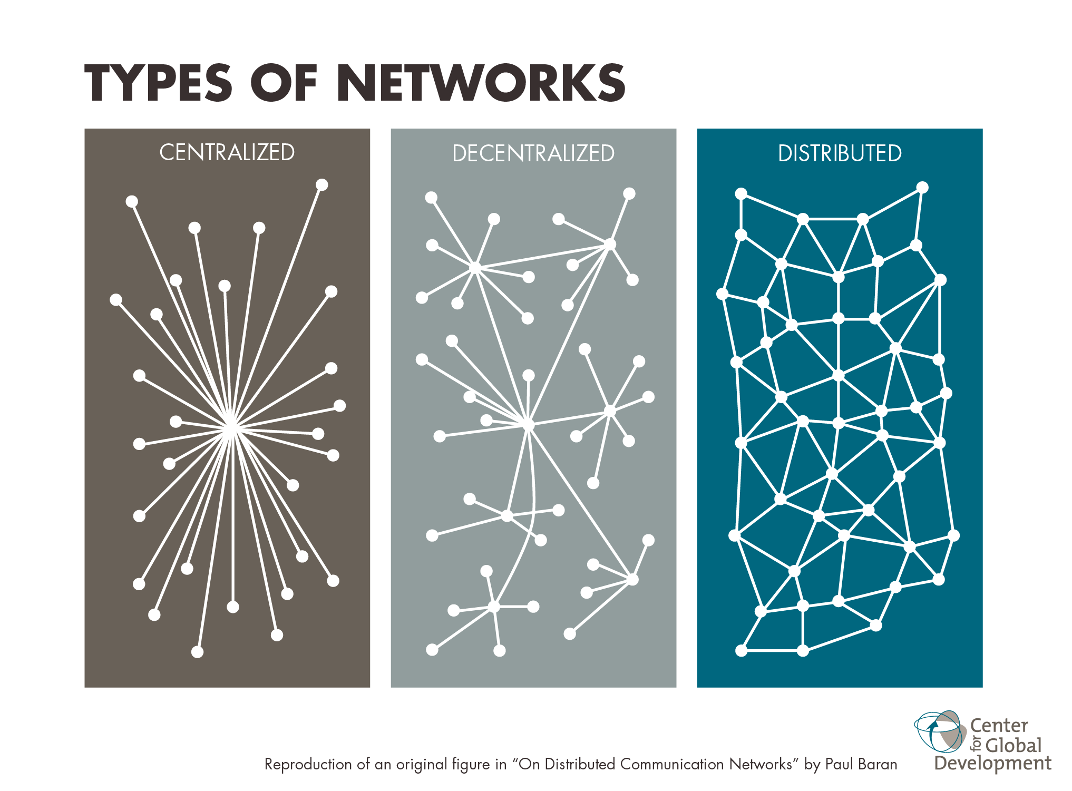

Slide 7
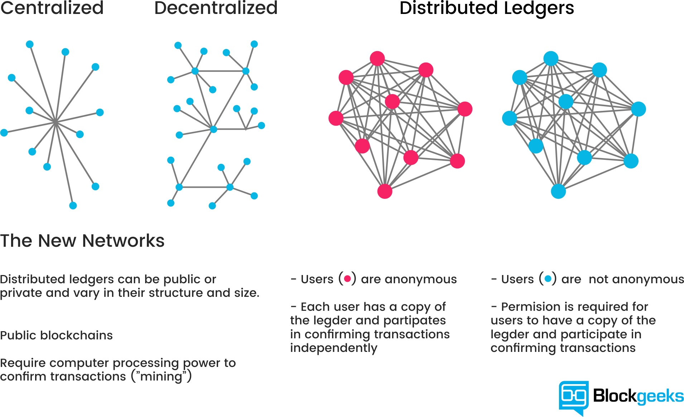

Slide 8
What Problems to Solve?
Centralized ledger (dependency)
High cost
Long processing time

Slide 9
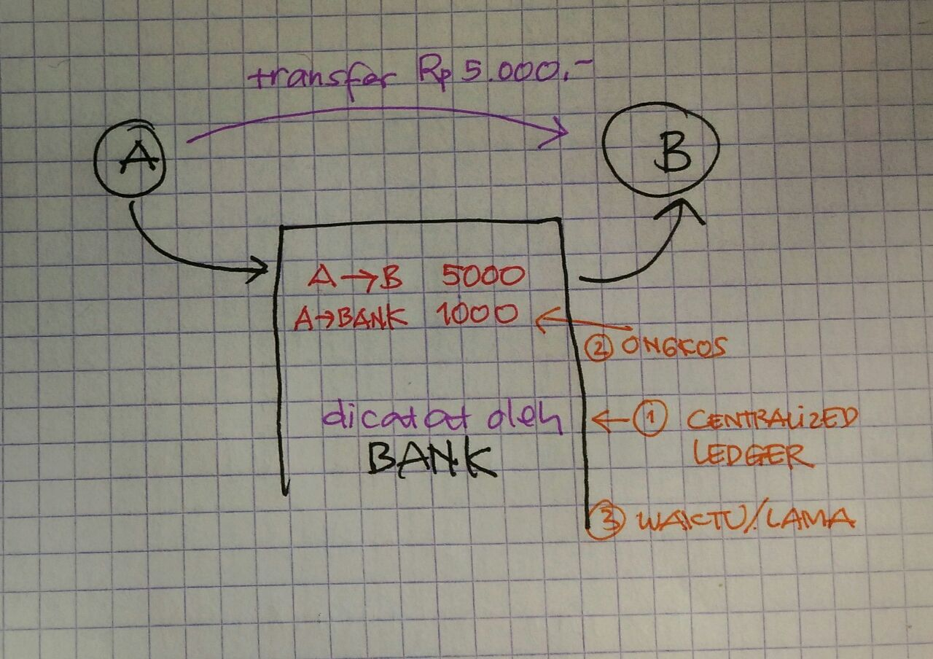
Conventional Transaction

Slide 10
Blockchain Technology
Remove centralized ledger, make it distributed
Create lower transaction fee
Faster transaction (instant)

Slide 11
Hash / Message Digest
Merupakan rangkuman dari sebuah pesan / text / message / stream of data
Merupakan fungsi satu arah (one way function) yang dapat menghasilkan ciri (signature) dari data (berkas, stream)
Mudah dihitung untuk satu arah (forward)
Sulit (hard) dihitung inverse-nya
Perubahan satu bit saja akan mengubah keluaran hash secara drastis
Digunakan untuk menjamin integritas dan digital signature

Slide 12
Fungsi Hash Sederhana
Menjumlahkan nilai ASCII dari karakter
Pesan: BUDI
DUDI = ?
No | Karakter | ASCII | Total
1 | B | 66 | 66
2 | U | 85 | 151
3 | D | 68 | 219
4 | I | 73 | 292

Slide 13
Hash Collision
What is a “collision”?
When two different data result in the same hash value
From our previous example: BUDI = IDUB
Hash function must have a low probability of collision
Examples of good hash function: MD5, SHA256

Slide 14
Example of Hash usage
Transaction:
ANI123 BUDI789 15000
Hash (MD5) of that transaction
34d5853c02351999525194d0c9a69345
Hash (SHA-256) of that transaction (note: longer)
f40ce0a90673486c0bb774feda524e0cb0557b0ae5bc6cd5029b6eb6ad1538cd

Slide 15
Example of Block #2
34d5853c02351999525194d0c9a69345
ANI123 BUDI789 15000
CECEP234 BUDI789 10000
BUDI789 DEDI 5000
41cff38a782117a21817cd493f1958ff
previous hash
current transactions
hash of this block
(becomes ”previous hash” in next block)

Slide 16
Example of Block #3
41cff38a782117a21817cd493f1958ff
BUDI789 ANI123 5000
...
previous hash
current transactions
hash of this block
(becomes ”previous hash” in next block)

Slide 17
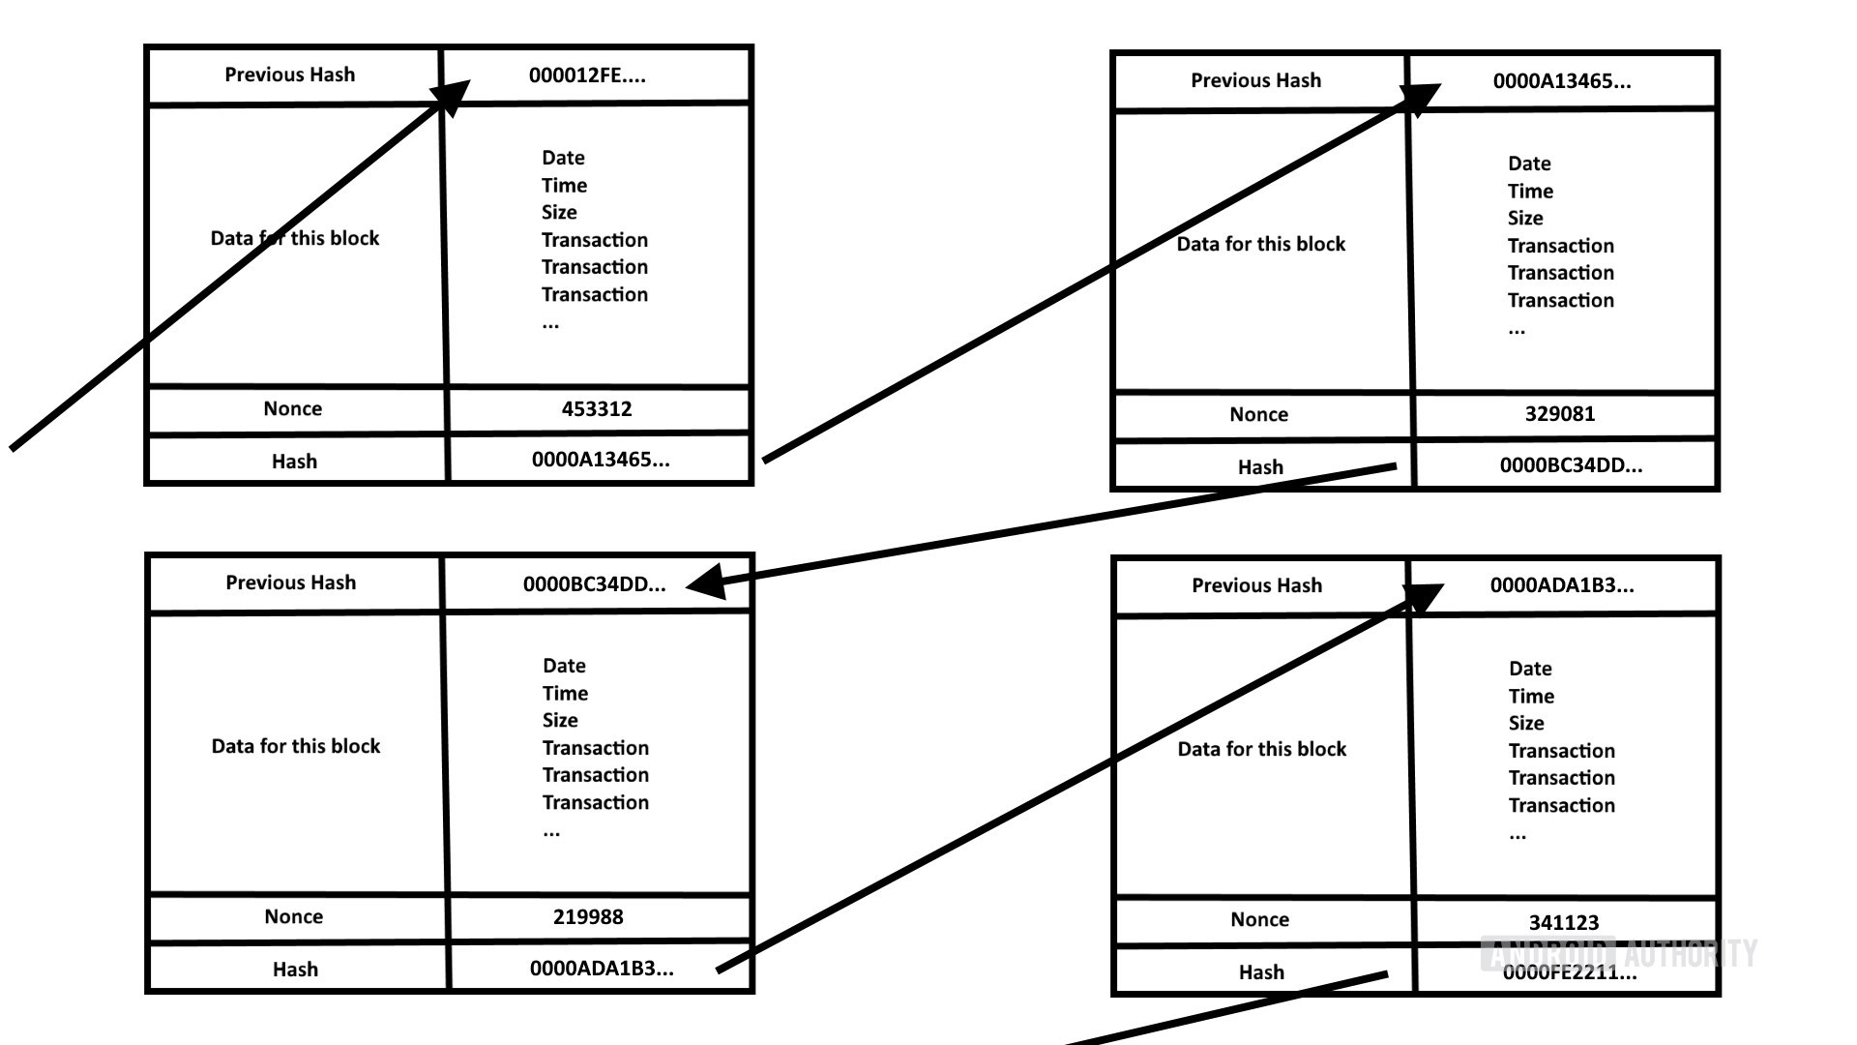

Slide 18
Opportunities

Slide 19
Blockchain-able
(Business) process that needs decentralized ledger
No trust. No need to have a centralized operator
NOT all blockchainable

Slide 20
Blockchain Ideas
Electronic voting
Electronic marketplace (decentralized ones)
Reputation central
...
Levels
Applications
Infrastructure
Technologies
Research examples
eVoting
Asuransi kesehatan
Pertanahan
Dapodik
Handphone curian/selundupan
...

Slide 21
How to Implement Blockchain

Slide 22


Two Major Platforms
Ethereum www.ethereum.org
Hyperledger www.hyperledger.org
There are “forks” of these two major platforms.
J.P. Morgan’s Quorum

Slide 23
Concluding Remarks
Blockchain technology is a game changer
The search for killer application(s) continues

